Slide 1
HOST MODULATION AGENTS
RUNGTA COLLEGE OF DENTAL SCIENCES AND RESEARCH
DEPARTMENT OF PERIODONTOLOGY FINAL YEAR BDS
PRESENTED BY:
Dr. Aena Jain Pundir
Professor
Dept. of Periodontology

Slide 2
Contents
Introduction
Sytemically administered agents
Non steroidal anti inflammatory drugs
Locally administered agents
Emerging host modulatory agents
Summary references

Slide 3
Specific learning objectives
Core areas | Domain | Category
Introduction | Affective | Desire to know
Systemically administered agnts | Cognitive | Must know
Non-steroidal anti inflammatory drugs | Cognitive | Must know
Locally administered agents | Psychomotor | Must know
Emerging host modulatory agents | Cognitive | Need to know

Slide 4
HOST MODULATORY THERAPY
DEFINITION
Host modulatory therapy (HMT) is a treatment concept that aims to reduce tissue destruction and stabilize or even regenerate the periodontium by modifying or downregulating destructive aspects of the host response and upregulating protective or regenerative responses.

Slide 5
HOST MODULATORY THERAPY
HMTs are systemically or locally delivered pharmaceuticals that are prescribed as part of periodontal therapy and are used as adjuncts to conventional periodontal treatments.
A variety of different drug classes have been evaluated as host modulation agents, including the nonsteroidal antiinflammatory drugs (NSAIDs), bisphosphonates, tetracyclines, enamel matrix proteins, growth factors, and bone morphogenetic proteins.

Slide 6
Systemically Administered Agents
NONSTEROIDAL ANTIINFLAMMATORY DRUGS
NSAIDs inhibit prostaglandins and therefore reduce tissue inflammation.
They are used to treat pain, acute inflammation, and a variety of chronic inflammatory conditions.
NSAIDs include the salicylates (e.g., aspirin), indomethacin, and the propionic acid derivatives (e.g., ibuprofen, flurbiprofen, naproxen).

Slide 7
NONSTEROIDAL ANTIINFLAMMATORY DRUGS
However, the NSAIDs have some serious disadvantages.
NSAIDs are associated with significant side effects, including gastrointestinal problems, hemorrhage (from decreased platelet aggregation), and renal and hepatic impairment.
The periodontal benefits of taking long-term NSAIDs are lost when patients stop taking the drugs, with a return to, or even an acceleration of, the rate of bone loss seen before NSAID therapy, often referred to as a “rebound effect.”

Slide 8
NONSTEROIDAL ANTIINFLAMMATORY DRUGS
NSAIDs (including the selective cyclooxygenase-2 (COX-2) specific inhibitors) are presently not indicated as adjunctive HMTs in the treatment of periodontal disease.

Slide 9
BISPHOSPHONATES
The bisphosphonates are bone-seeking agents that inhibit bone resorption by disrupting osteoclast activity.
Bisphosphonates interfere with osteoblast metabolism and secretion of lysosomal enzymes.
Bisphosphonates also possess anticollagenase properties.

Slide 10
BISPHOSPHONATES
Some bisphosphonates have the unwanted effects of inhibiting bone calcification and inducing changes in white blood cell counts.
Also, there have been recent reports of avascular necrosis of the jaws following bisphosphonate therapy, with the resultant risk of bone necrosis following dental extractions.
As with NSAIDs, at present there are no bisphosphonate drugs that are approved and indicated for treatment of periodontal disease.

Slide 11
SUBANTIMICROBIAL-DOSE DOXYCYCLINE
Subantimicrobial-dose doxycycline (SDD) is a 20-mg dose of doxycycline (Periostat) that is approved and indicated as an adjunct to SRP in the treatment of chronic periodontitis.
It is taken twice daily for 3 months, up to a maximum of 9 months of continuous dosing.
The 20-mg dose exerts its therapeutic effect by enzyme, cytokine, and osteoclast inhibition rather than by any antibiotic effect.

Slide 12
SUBANTIMICROBIAL-DOSE DOXYCYCLINE
SDD is the only HMT specifically indicated for the treatment of chronic periodontitis that is approved by the U.S. Food and Drug Administration (FDA) and accepted by the American Dental Association (ADA).

Slide 13
Locally Administered Agents
NONSTEROIDAL ANTIINFLAMMATORY DRUGS
Topical NSAIDs have shown benefit in the treatment of periodontitis.
To date, topically administered NSAIDs have not been approved as local HMTs for the management of periodontitis.

Slide 14
ENAMEL MATRIX PROTEINS, GROWTH FACTORS, AND BONE MORPHOGENETIC PROTEINS
Other agents include enamel matrix proteins (Emdogain), bone morphogenetic proteins (BMP-2, BMP-7), growth factors (platelet-derived growth factor, insulin-like growth factor), and tetracyclines.
The only local host modulation agent currently approved by the FDA for adjunctive use during surgery is Emdogain.

Slide 15
SUBANTIMICROBIAL-DOSE DOXYCYCLINE
SDD is currently the only FDA-approved, systemically administered HMT indicated specifically in the treatment of periodontitis.
SDD is used as an adjunct to SRP and must not be used as a standalone therapy (monotherapy).
Because SDD, previously called “low-dose doxycycline” (LDD) and currently marketed as Periostat, is based on subantimicrobial dosage of doxycycline, a member of the tetracycline family of compounds, the use of tetracyclines for the management of periodontal diseases must be put in perspective.

Slide 16
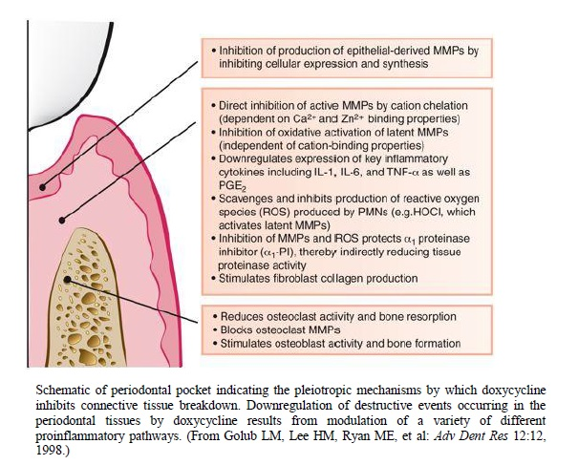
Mechanisms of Action

Slide 17
Treatable Periodontal Conditions
SDD is indicated in the management of chronic periodontitis.
SDD should not be used in conditions such as periodontal abscess or when an antibiotic is indicated.
SDD can be used in patients with aggressive periodontitis who are being treated nonsurgically.
SDD can also be used as an adjunct to periodontal surgery.
SDD may also be of benefit in cases that are refractory to treatment, as well as in patients with risk factors such as smoking or diabetes, in whom the treatment response might be limited.

Slide 18
Side Effects
Doxycycline at antibiotic doses (≥100 mg) is associated with adverse effects, including photosensitivity, hypersensitivity reactions, nausea, vomiting, and esophageal irritation.
There was no evidence of adverse events that could be attributed to antimicrobial effects of treatment and no evidence of developing antibiotic resistance of the microflora.
Therefore the drug appears to be well tolerated, with a very low incidence of adverse effects.

Slide 19
Sequencing Prescription with Periodontal Treatment
SDD therapy is commenced at the start of initial periodontal therapy and continues for 3 months until the first maintenance appointment.
At maintenance appointments, the need for further prescription of SDD can be assessed.
For patients demonstrating a good treatment response with significant reductions in probing depths, further SDD may not be necessary.

Slide 20
Combining with Local Delivery Systems
SDD treatment can also be combined with the local delivery of antibiotics into the periodontal pocket through sustained-delivery systems.
The two treatment approaches target different aspects of the pathogenic process: local delivery systems deliver antimicrobial concentrations of an antibacterial agent directly into the site of the pocket, whereas SDD is a systemic host response modulator.

Slide 21
EMERGING HOST MODULATORY THERAPIES
One of the most promising groups of potential HMTs is the chemically modified tetracyclines (CMTs).
These nonantibiotic tetracycline analogs are tetracycline molecules that have been modified to remove all antibiotic properties, but which retain host modulatory, anticollagenolytic effects.

Slide 22
EMERGING HOST MODULATORY THERAPIES
CMTs such as CMT-3 and CMT-8 (both of which lack antibiotic activity but retain anti-MMP activity) have been shown to inhibit osteoclastic bone resorption and promote bone formation, enhance wound healing, and inhibit proteinases produced by periodontal pathogens.

Slide 23
Summary
The concept of host modulation was first introduced to dentistry by Williams and Golub et al. HMT is a means of treating the host side of the host-bacteria interaction.HMTs ameliorates excessive or pathologically elevated inflammatory processes to enhance the opportunities for wound healing and periodontal stability. Bisphosphonate therapy can lead to avascular necrosis of the jaws, with resultant risk of bone necrosis following dental extractions. Chemically modified tetracyclines (CMTs) are nonantibiotic tetracycline analogs are tetracycline molecules that have bee modified to remove all antibiotic properties, but which retain host modulatory, anticollagenolytic effects. An FDA-approved agent for host modulation treatment of periodontal disease is sub-antimicrobial–dose doxycycline (SDD) at 20 mg, taken twice daily.

Slide 24
References
Newman MG, Takei HH, Klokkevold PR, Carranza FA. Carranza’s clinical periodontology, 10th ed. Saunders Elsevier; 2007.
Lindhe J, Lang NP and Karring T. Clinical Periodontology and Implant Dentistry. 6th ed. Oxford (UK): Blackwell Publishing Ltd.; 2015.

